Slide 1
LAB 1
Installation of Linux (Ubuntu)
Instructor info:
Name:
Email:

Slide 2
Linux (Ubuntu) Installation

Slide 3
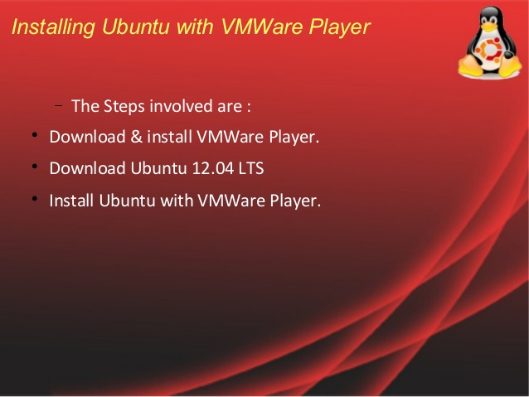

Slide 4
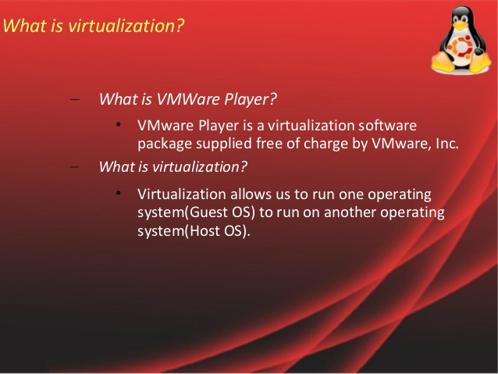

Slide 5
Linux (Ubuntu) Installation
VMware, Inc. is a subsidiary of Dell Technologies that provides cloud computing and platform virtualization software and services
Was the first commercially successful company to virtualize the x86 architecture

Slide 6
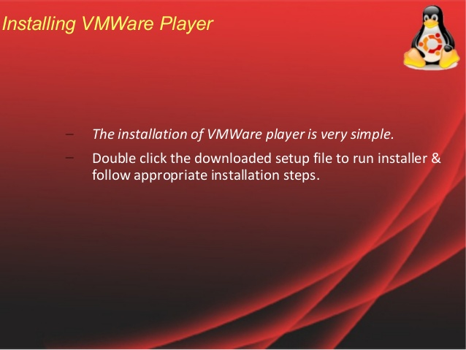

Slide 7
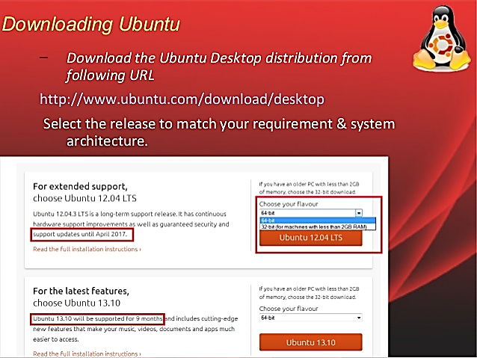

Slide 8
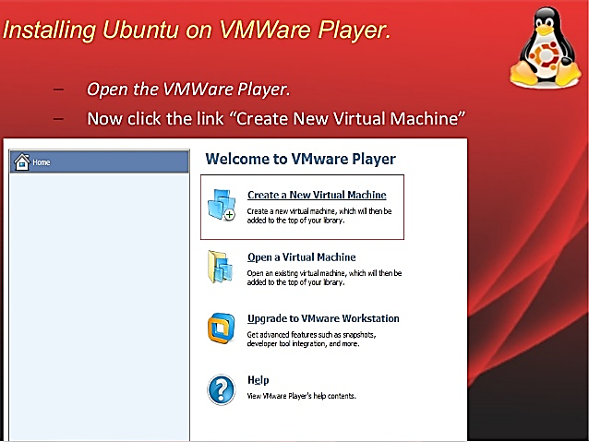

Slide 9
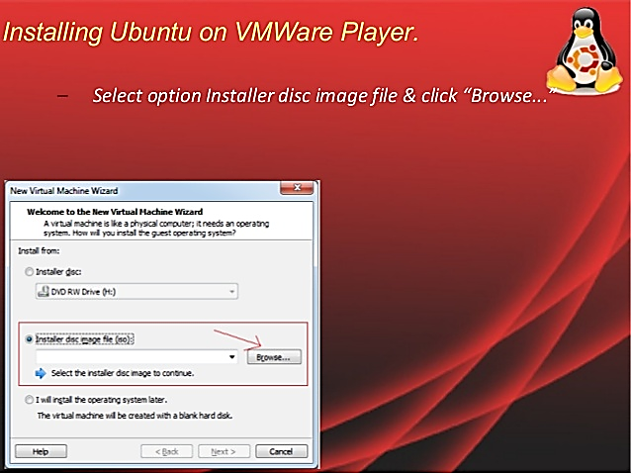

Slide 10
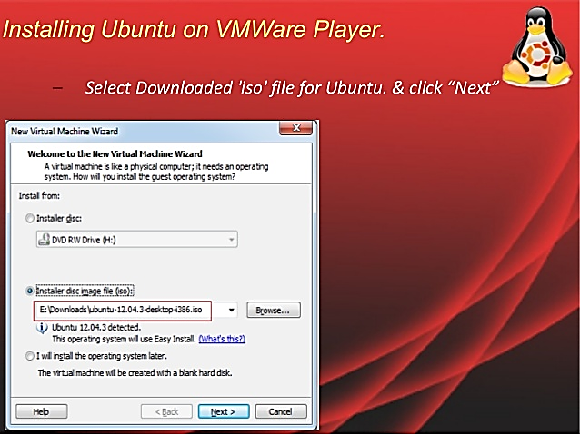

Slide 11
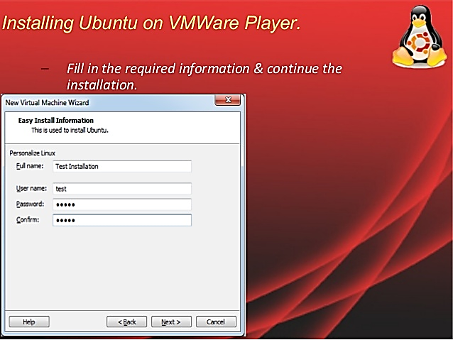

Slide 12
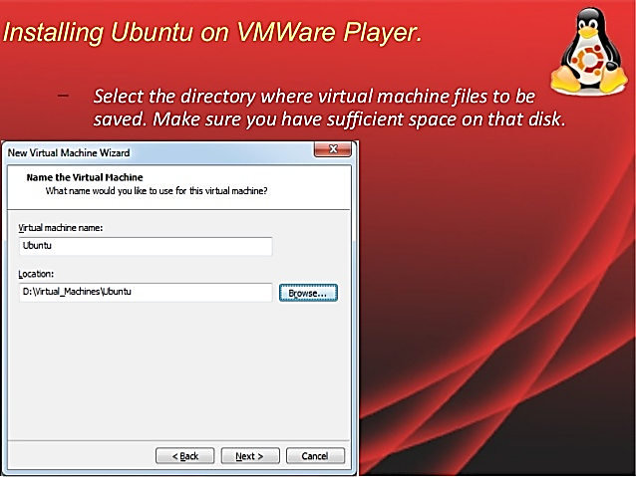

Slide 13
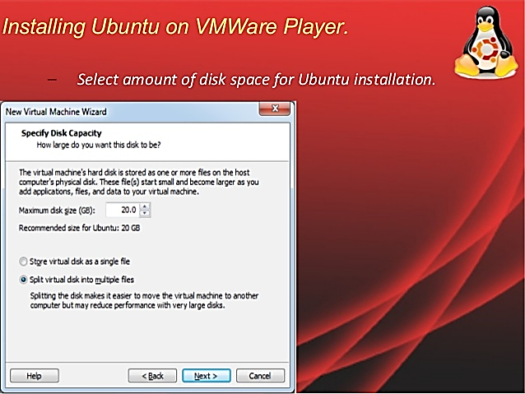

Slide 14
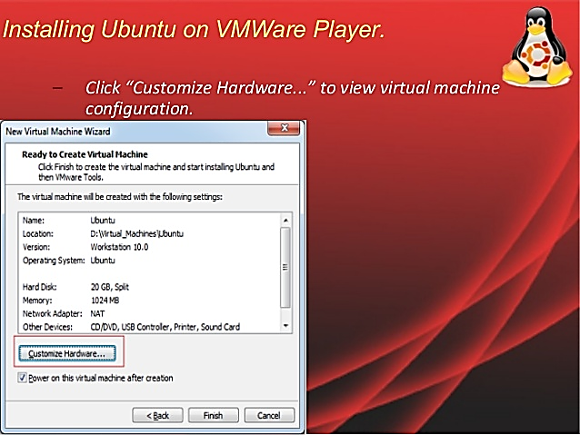

Slide 15
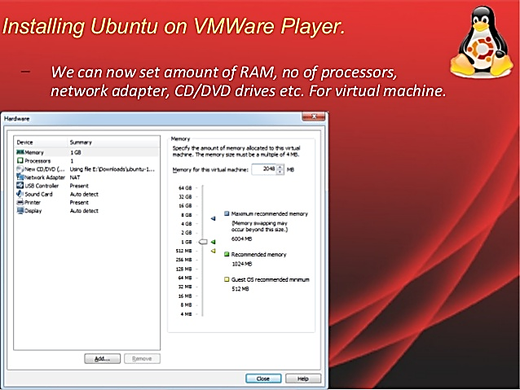

Slide 16
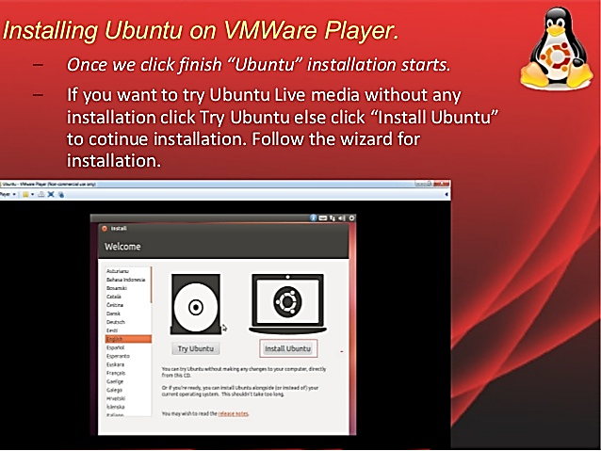

Slide 17
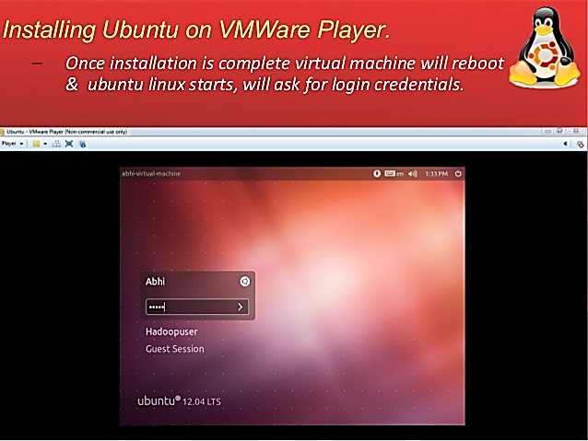

Slide 18
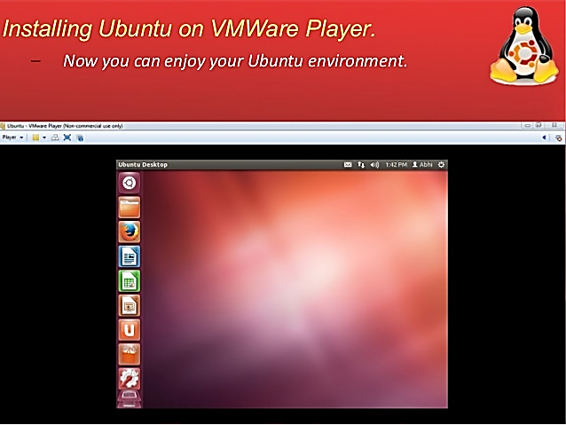

Slide 19
Compilers Installation
Following compilers are used for C and C++ language:
For C language: gcc
Command: sudo apt-get install gcc
For C++ Language: g++
Command: sudo apt-get install g++

Slide 20
Test g++ Compiler Installation
Create file by right click and name it as “test.cpp”
Add this code into file and save:
Compile this code using following steps:
To compile: g++ -o obj test.cpp
To run: ./obj
Done, Check the output on command prompt
#include<iostream>
using namespace std;
int main()
{
cout<< “Testing G++ Compiler!!!!!!!”;
cout<< “Yes, G++ Compiler working Perfectly!!!!!!!”;
return 0;
}

Slide 21
Test gcc Compiler Installation
Create file by right click and name it as “test.c”
Add this code into file and save:
Compile this code using following steps:
To compile: gcc -o obj test.c
To run: ./obj
Done, Check the output on command prompt
#include<stdio.h>
void main() {
printf("Hello! This is my first C program with Ubuntu 11.10\n");
/* Do something more if you want */
}

